Slide 1
HyperParameter Tuning

Slide 2
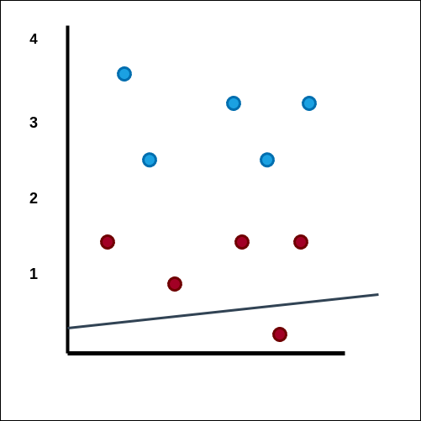
Training Phase Starts
Goal - The line (is the rule) which separates the two labels (good and average) students
Blue - Good Students Red - Average Students
Formulae of a straight line: Y = mx + c .

Slide 3
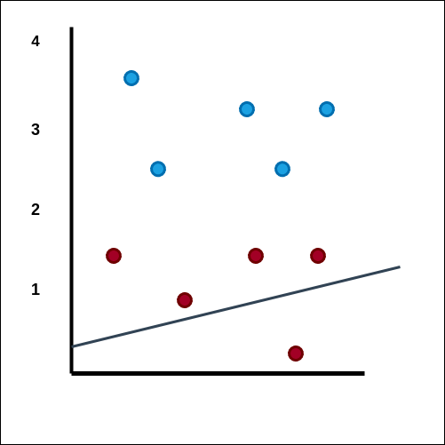

Slide 4
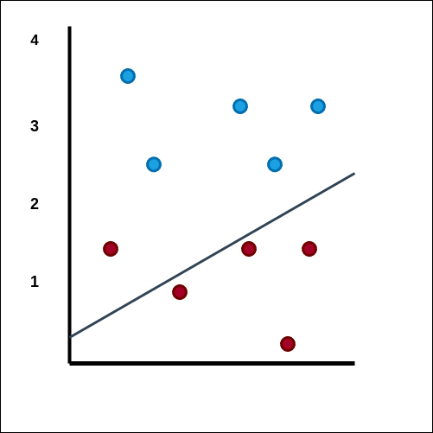

Slide 5
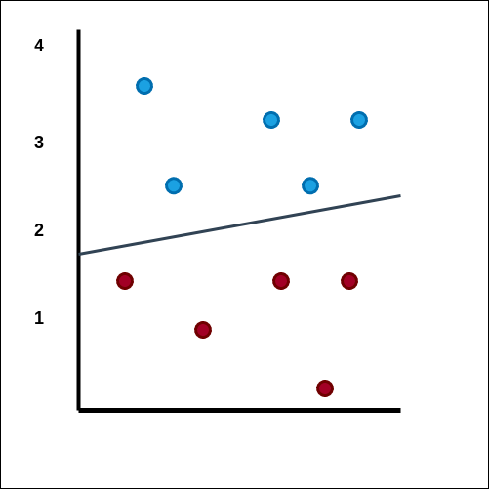

Slide 6
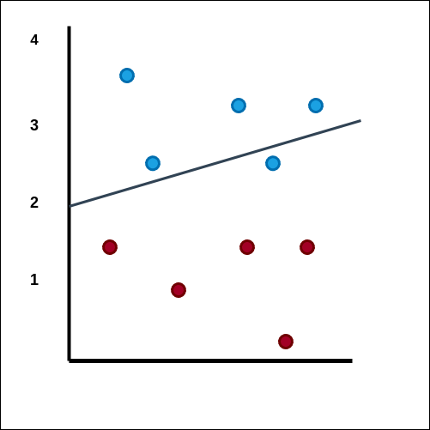

Slide 7
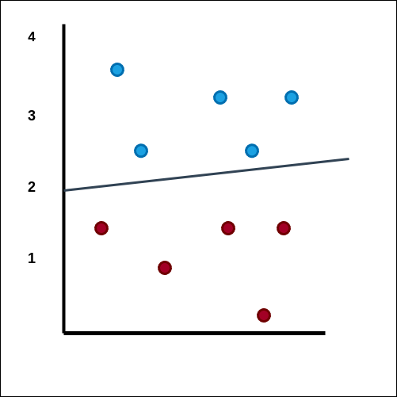
Here, value of m and c changes so that our line splits the different
labels into two different groups.
Training COMPLETE

Slide 8
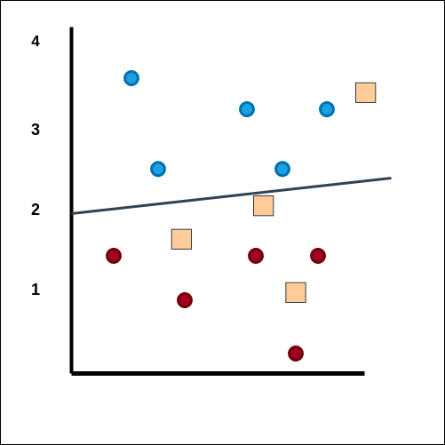
Testing Phase Begins

Slide 9
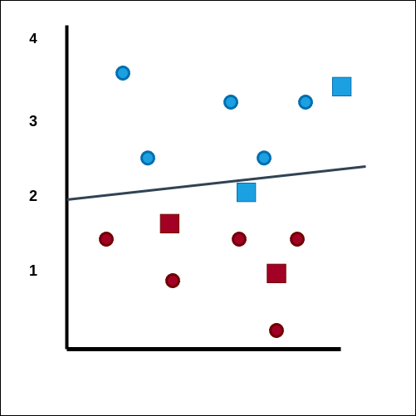
Calculate the accuracy.

Slide 10
Hyper Parameter
What is a parameter
What is a hyperparameter

Slide 11
Hyper Parameter Tuning
Training → Studying For the Exam
Testing → Giving the exam

Slide 12
Overfitting
Learns the Training Data too well.
Can not generalize to unseen (test data).

Slide 13
Overfitting Proof In ML model
High train accuracy / any other metric
Low test accuracy

Slide 14
The solution ? (for large dataset)
Training → Studying For the Exam
Validation → Giving Mock Exam
Testing → Giving the exam (Only once)

Slide 15
Training - Validation - Test
Dataset
Train
Test
Train
Validation

Slide 16
The End

